Slide 1

Kyrgyz Headline Generation using Transformers
We developed a machine learning model that generates headlines in Kyrgyz.
Our focus was to apply advanced NLP on a low-resource language with real news data.
Commands:Aktan,Dastan,Elzar,Argen,Bayzbek,Emilbek

Slide 2


Mission
Expand NLP Access
Automate Headlines
Improve access to NLP tools for Kyrgyz-language users.
Automatically generate headlines for articles and media content.

Slide 3
Dataset Overview
Article Text
Headline
Contains 100 to 400 words summarizing news stories.
Short title summarizing the article content effectively.

Slide 4

Dataset Details
Size & Cleaning
Input Limit & Split
About 1,700 samples, duplicates and nulls removed.
Max 512 tokens per input; 90% training, 10% validation.

Slide 5
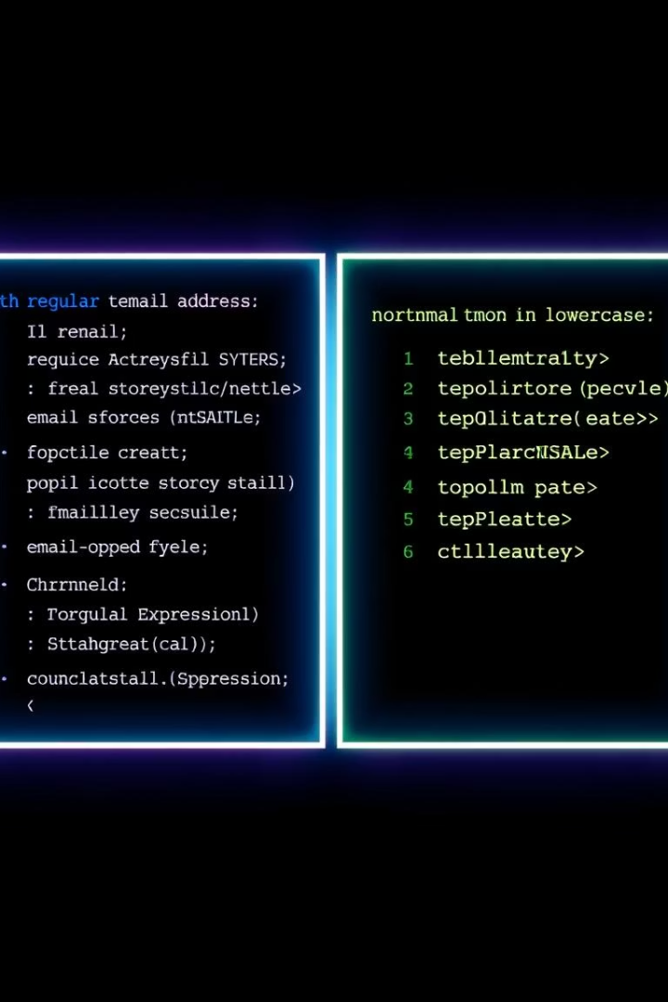





Preprocessing Steps
Data Cleaning
Remove duplicates, nulls, unwanted characters.
Normalization
Standardize text format and whitespace.
Dataset Splitting
Create training and validation sets.
Tokenization Prep
Prepare data for tokenizer input.

Slide 6
Model Choice
Multilingual Models
Architecture
Used mT5 supporting Cyrillic and low-resource languages.
Encoder-decoder structure ideal for sequence-to-sequence tasks.

Slide 7



Tokenization
Special Tokens
Used start/end sequence markers to guide the model.
Separate Tokenization
Padding & Masks
Input text and headline tokenized individually.
Uniform input length with attention masks for focus.
2
1
3

Slide 8

Training Process
Epochs & Batch Size
Optimizer & Loss
3 to 5 epochs with batch size 4 to 8 depending on memory.
AdamW optimizer and CrossEntropy loss function used.
Validation & Early Stopping
Monitored metrics and stopped early to prevent overfitting.

Slide 9
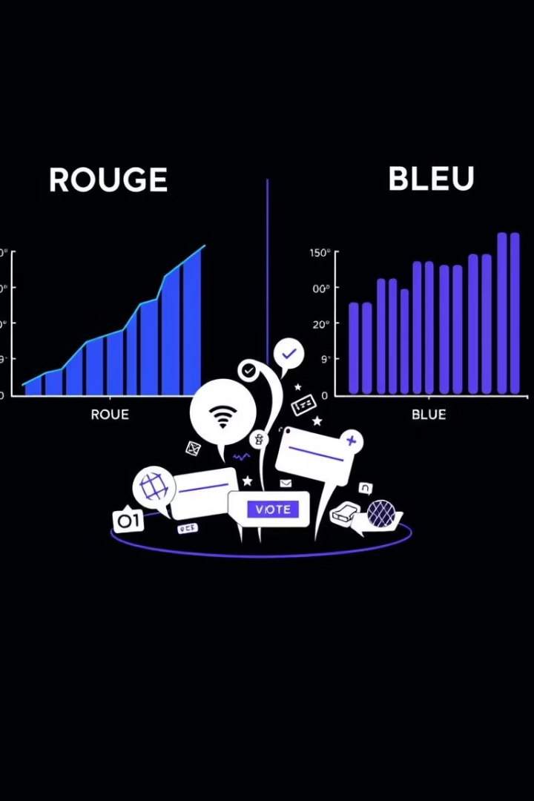
Evaluation Metrics
ROUGE
BLEU
Measures overlap between generated and reference headlines.
Assesses similarity to reference using n-gram matching.
Manual Checks
Contextual accuracy and meaning verified by humans.

Slide 10

Results & Examples
The model generated short and context-relevant headlines;
It captured the main theme of the article in most cases;
In some examples, it paraphrased well without losing meaning.
Example:
Input Text: News about a school opening;
Generated Headline: "Жаңы мектеп ачылды" (A new school opened)
This proves the model learned to understand and summarize effectively.

Slide 11
Challenges We faced several challenges:
Lack of Kyrgyz-specific pretrained models;
Limited and imbalanced dataset;
Some texts had grammatical or spelling errors;
The model sometimes produced grammatically incorrect outputs;
Hyperparameter tuning was critical to avoid overfitting on a small dataset.
Despite this, our results were promising and practical.

Slide 12
Insights & What We Learned This project taught us valuable lessons:

